Slide 1
C# Fundamentals
Language-Integrated Query

Slide 2
C# Language-Integrated Query Definition
LINQ is an acronym for Language Integrated Query.
LINQ introduces standard, easily-learned patterns for querying and updating data, and the technology can be extended to support potentially any kind of data store
“Language Integrated ” means that LINQ is part of programming language syntax and “Query” explain what LINQ does “Used for querying data”.

Slide 3
C# Language-Integrated Query Types of Data
LINQ can be used to query many different types of data :
Linq to Objects
Linq to Datasets
Linq to SQL
Linq to Entities
Linq to XML

Slide 4
C# Language-Integrated Query Linq to Objects
The term "LINQ to Objects" refers to the use of LINQ queries with any IEnumerable or IEnumerable<T> collection directly.
You can use LINQ to query any enumerable collections such as :
List<T>
Array
Dictionary<TKey, TValue>

Slide 5
C# Language-Integrated Query Linq to Objects
Extension Methods
// getting all names that are equal to “Frodo”
List<string> names = new List<string>() { “Frodo”, “Sam”, “Merry”, “Coco” };
var resQuery = names.Where( n => n.Equals(“Frodo”) );
// getting all Even numbers
int[] numbers = new int[7] { 0, 1, 2, 3, 4, 5, 6 };
var list2 = numbers.Where( x => (x % 2) == 0 );
// OderBy
int[] ints = { 10, 45, 15, 39, 21, 26 };
var result = ints.OrderBy(g => g);

Slide 6
C# Language-Integrated Query Linq to Objects
Query Expressions
var names = new List<string> { "Bruce Banner", "Peter Paker", "Clark Kent" };
var query = from name in names
where name.EndsWith("er")
orderby name.Length
select name;
foreach (var n in query)
{
Console.WriteLine(n);
}

Slide 7
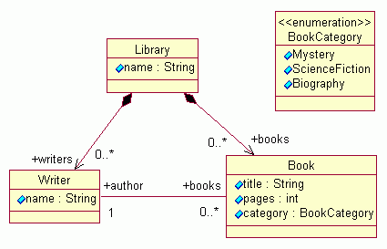
C# Language-Integrated Query Linq to Objects
Implement a Library application that allows the user to search books by different criterias(Title, Author, Category), and see the result in order.

